Slide 1


DEPARTMENT OF INFORMATION TECHNOLOGY
Project name : ENVIRONMENT MONITORING
Team name : :Proj_224786_Team_5
Team members : JEEVAN SIVA SANKAR A (113321205021) SELVA KUMARAN T (113321205046) SRIDHAR B (113321205051)
SABAREES (113321205301)

Slide 2
Problem Statement:
In today’s rapidly changing world,there is a growing concern about the state of environment.Climate change,pollution and natural disasters are posing significant threats to our planet and the well-being of it’s inhabitants.To adress these challenges,there is a processing need for an advanced Environment Monitoring System(EMS)that can provide real-time data on key environmental parameters.This system should be capable of monitoring and reporting on factors such as air quality,temperature,humidity,water quality and more in various location and ecosystems.

Slide 3
Objectives:
Assessment Of Environmental Quality:
To evaluate the overall health and quality of natural ecosystems including air,water,soil and biodiversity.
Detection Of Pollution:
To identify and quantify the presence of pollutants,contaminants and hazardous subsatnces in the environment.
Early Warning Of Environmental Risks:
To provide timely warnings of potential environmental disasters,such as floods,wildfires,or chemical spills.
Compliance Monitoring:
To ensure that industrial and human activities are in compilance with environmental laws and regulations.

Slide 4
Protection Of Biodiversity:
To monitor and conserve biodiversity by assessing the health and populations of various species and ecosystems.
Resource Management:
To support sustainable management of natural resources such as fisheries,forests and water sources througgh data-driven decision-making.
Public Health Protection:
To safeguard public health by monitoring air and water quality to detect potential health hazards.

Slide 5
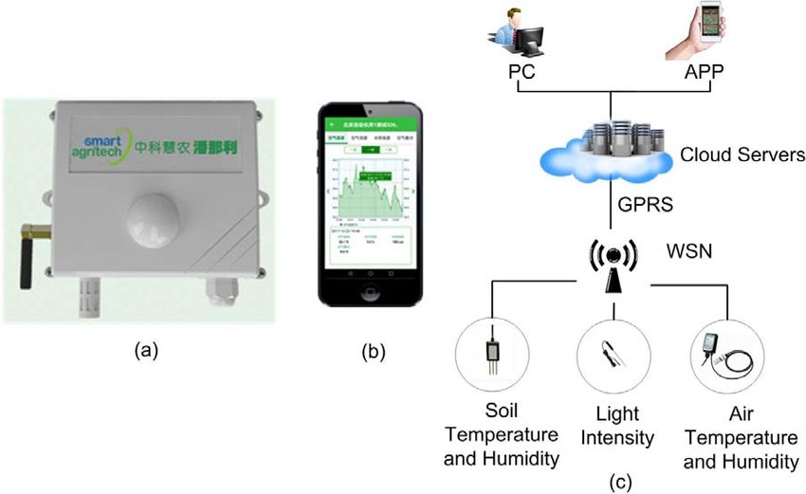
IOT SENSOR DESIGN:

Slide 6
IOT Sensors Design:
There are several IOT sensors and components that are used in Environment Monitoring.some of them are as follows:
Temperature Sensor
Humidity Sensor
Air Quality Sensor
Gas Sensor
Sound Sensor
Soil Moisture Sensor
Light Sensor
Water Level Sensor
Pressure Sensor

Slide 7
Real-Time Transit Information Platform:
Creating a real time transit information platform as part of an environmental monitoring project can be valuable for various applications,especially in urban environments.Here’s how it can be implemeted:
Data Source
Data Processing
User Interface
Environmental Insights
Communication
Integration
Accessibility
Data Security and Privacy
Continuous Improvement

Slide 8
THANK YOU

